Slide 1
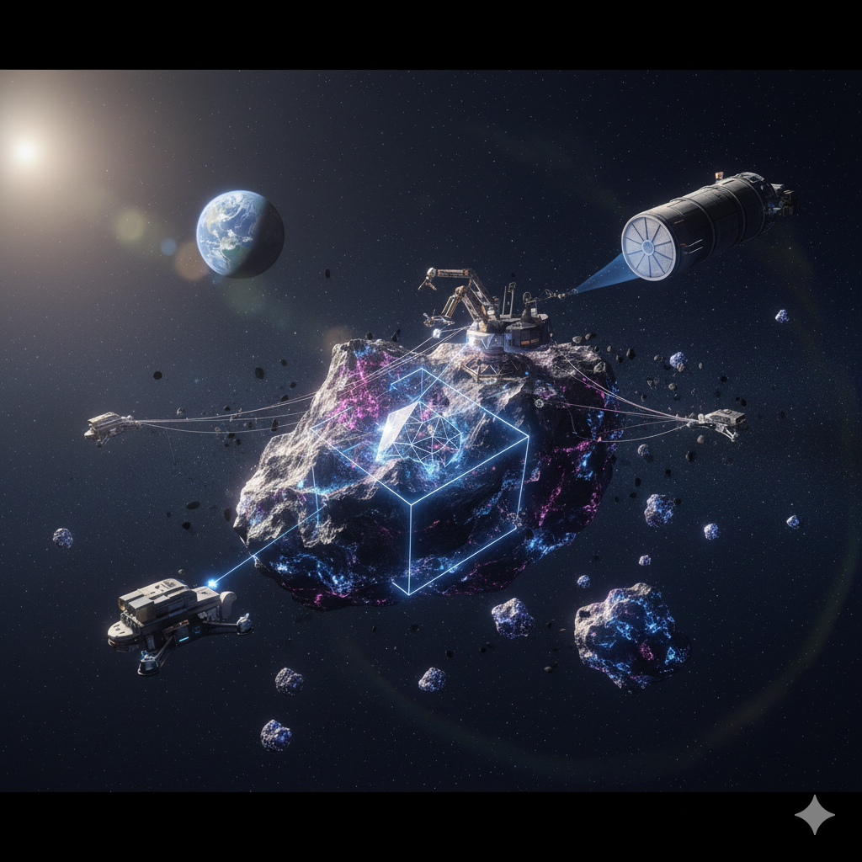
SPACE MINING

Slide 2
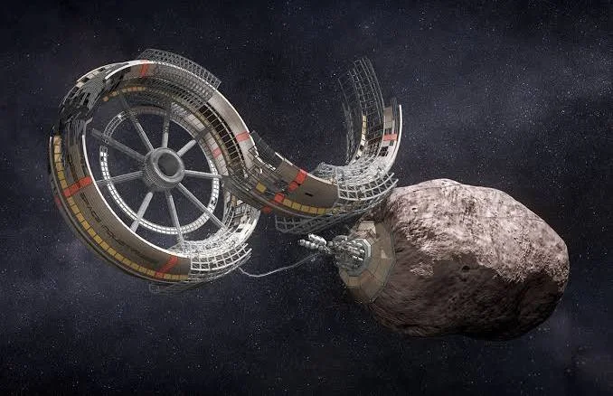
INTRODUCTION
Space mining is the process of exploring for and extracting valuable resources like rare minerals, metals, water, and gases from celestial bodies such as asteroids, the Moon, and other planets.
Need of space mining is to get rear earth metals and prevent depletion of earth resource, and to make use of extraterrestrial resources .
NASA’s Artemis mission plans to establish a sustainable human presence on the Moon by 2028, and in-situ resource utilisation (ISRU) will play a critical role. Extracting resources like water directly from the lunar surface could drastically reduce the cost and complexity of these missions.

Slide 3
NEED OF ROBOTICS IN SPACE MINING
Need for autonomous robotics in space mining environment
advanced robots: autonomous operation, self-repair, adaptability to microgravity and harsh conditions
Impact of infinite budget on accelerating innovation and achieving breakthroughs

Slide 4
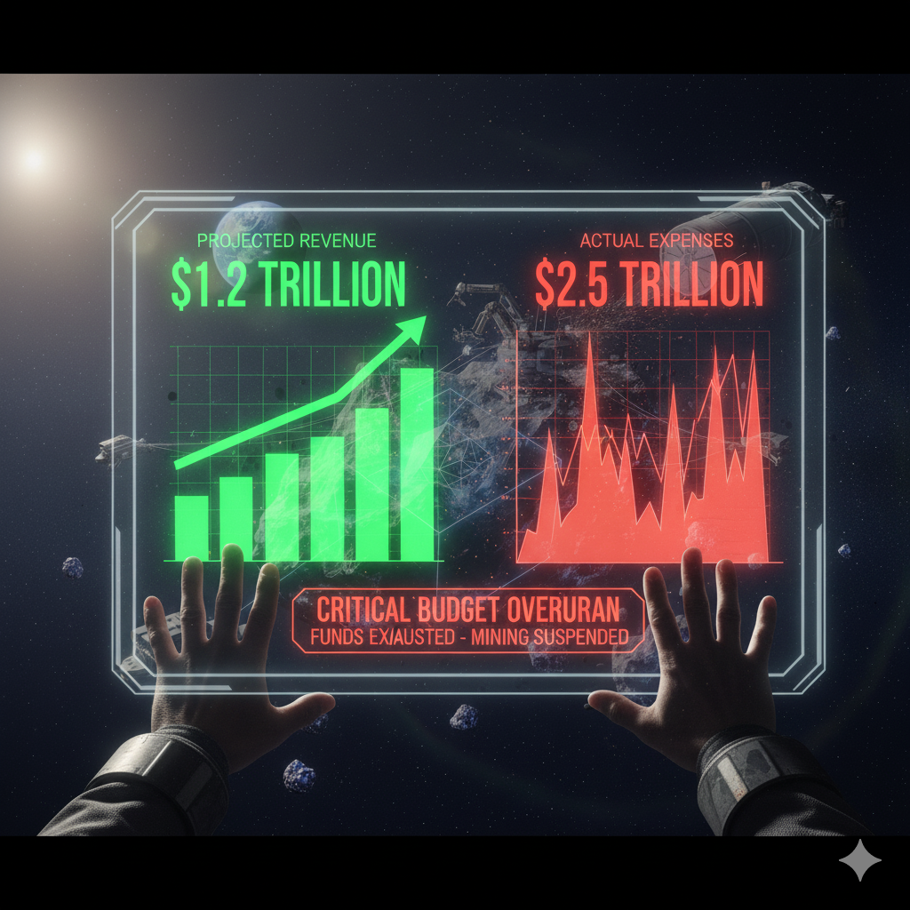

CHALLENGES
Budget problem
Mining & Processing in Microgravity
Energy Problem

Slide 5
GENERAL PLAN
Phase 1: Research & Development
Design autonomous robotic miners with AI and self-repair capabilities.
Develop advanced materials for space durability.
Simulate asteroid environments on Earth.
Phase 2: Prototyping and Testing
Build prototype mining robots.
Conduct vacuum and microgravity testing.
Demonstrate autonomous mining on small NEAs.
Phase 3: Deployment
Launch fleets of mining robots to target asteroids.
Robots perform excavation, processing, and material transfer to processing hubs or orbiting facilities.
Phase 4: Expansion
Expand mining operations to multiple asteroids.
Use mined materials for in-space manufacturing, habitats, and fuel.

Slide 6
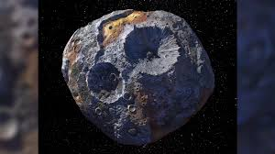
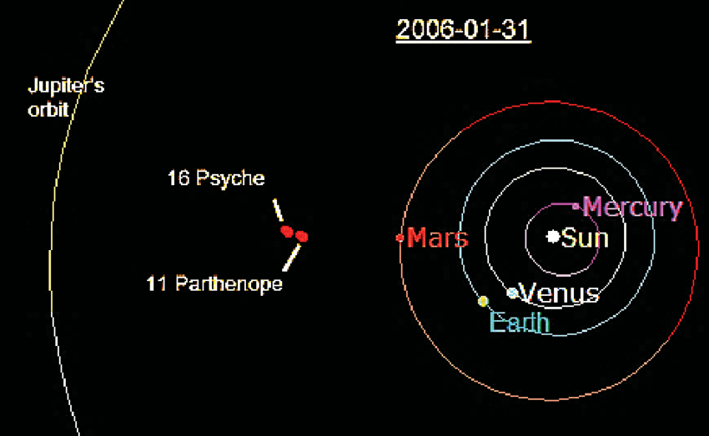
EXAMPLES/CASE STUDY
Asteroid 16 Psyche
Metal-rich main belt asteroid (~30-60% metal by volume).
Thought to be the exposed iron-nickel core of an early planetesimal.
Estimated metal value: trillions to quadrillions of dollars (theoretical).
Targeted by NASA’s Psyche mission (scientific exploration, not mining).
Challenges: distance (~2.5–3.3 AU), unknown structure, and complex surface.

Slide 7
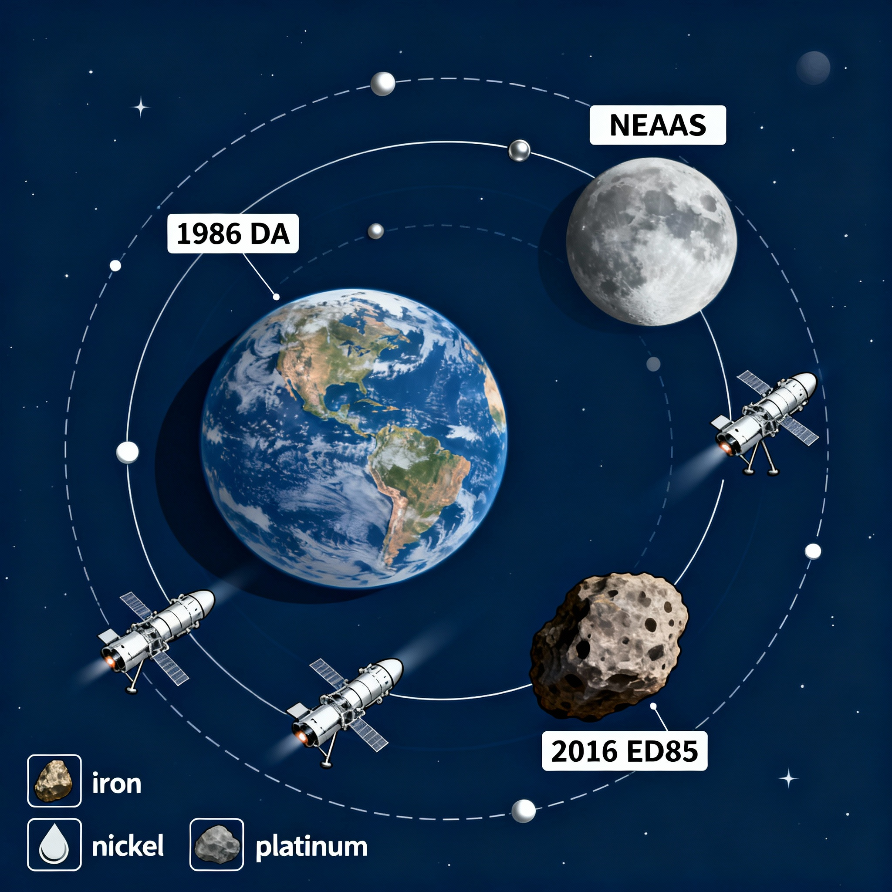
Near-Earth Asteroids (NEAs)
Examples: 1986 DA and 2016 ED85, metal-rich near-Earth asteroids (~85% metal).
Advantages over 16 Psyche:
Closer to Earth, reducing mission cost/time.
Easier access to support mining demonstrations.
Potential metals: iron, nickel, cobalt, platinum-group
metals.
Serve as ideal first targets for robotic mining missions.

Slide 8
CONCLUSION
Asteroid mining requires innovative robotics to solve technical and environmental challenges.
Infinite budget accelerates development of autonomous mining fleets.
Combining robotic tech advances with exploration of asteroids like 16 Psyche and accessible NEAs can unlock vast new resource frontiers.
Strategic investment in robotics is key to humanity's sustainable presence in space.

